Slide 1

105 Classification Models
Sunil Gorantla

Slide 2
Decision Trees
Decision Tree methods construct a model of decisions made based on actual values of attributes in the data.
Decisions fork in tree structures until a prediction decision is made for a given record.
Decision trees are trained on data for classification and regression problems.

Slide 3
Criteria for splitting (Information Gain, Gini Impurity)

Slide 4
Entropy
Entropy: A measure of uncertainty or impurity in a dataset.
Formula: Entropy = -Σ(P(i) * log2(P(i))) (where P(i) is the probability of class i).
Range: Entropy ranges from 0 (pure or homogeneous) to log2(n) (maximum heterogeneity).
Example:
For a node with 80% "yes" and 20% "no":
Entropy = -(0.8log2(0.8) + 0.2log2(0.2)) ≈ 0.72

Slide 5
Gini Impurity
Gini Impurity: A measure of how often a randomly chosen element would be incorrectly classified.
Formula: Gini = 1 - Σ(P(i)^2 ). (where P(i) is the probability of class I in category).
Range: Gini Impurity ranges from 0 (perfectly homogeneous) to 0.5 (most heterogeneous in binary classification).
Example:
Suppose a node has 80% "yes" and 20% "no".
Gini = 1 - (0.8^2 + 0.2^2) = 0.32

Slide 6
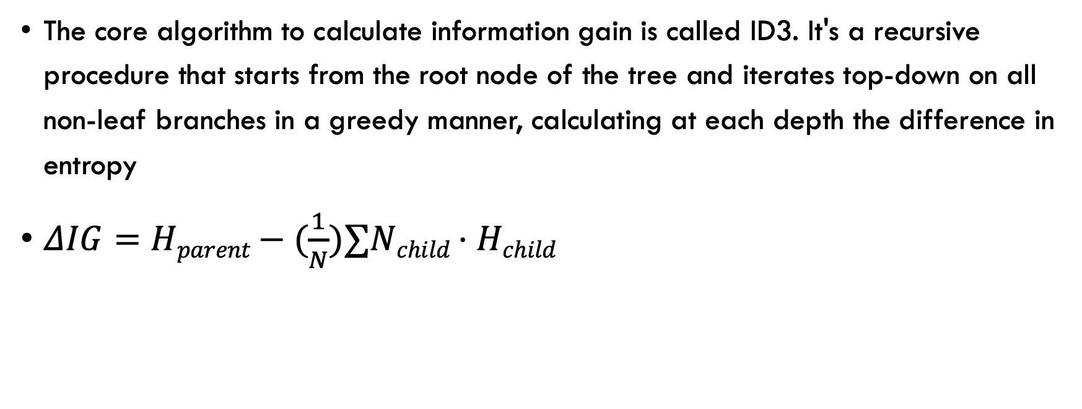
Information Gain
The core algorithm to calculate information gain is called ID3. It's a recursive procedure that starts from the root node of the tree and iterates top-down on all non-leaf branches in a greedy manner, calculating at each depth the difference in entropy

Slide 7
Parameters and Hyper-Parameters
Parameters:
Slip points at each node: The values in the dataset that are used to split the data in into two or more homogeneous sets.
Feature selection at each node: The actual features that are chosen to make the split at each node.
Hyper Parameters:
Criterion: Quality of split. (Gini or entropy)
Max depth: the maximum depth of the tree
Min Samples Split: Minimum number of samples required to make a split.
Min Samples Leaf: Minimum number of sample required to be present in the leaf nodes.
Max Features: The number of features to consider when looking for best split. This can be used to increase randomness.
Max Leaf Nodes: Maximum number of leaf nodes that a tree can have.
Min Impurity Decrease: Node will be split if the split induces a decrease of impurity greater than or equal to this value.

Slide 8
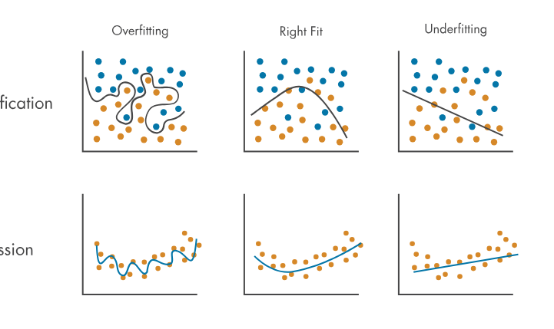
Over Fitting vs Underfitting
Overfitting: occurs when the model learns the information and noise in the training dataset. This means the model is too complex and fit the training data too closely
Underfitting: refers to a models that can neither model the training data nor generalize the new data. An underfitted model overly simple and fails to capture the underlying trend of the data

Slide 9

Random Forest

